Slide 1


St. MARTIN’S ENGINEERING COLLEGE
UGC Autonomous
NBA & NAAC A+ ACCREDITED
Dhulapally, Secunderabad– 500100
Department of Computer Science And Engineering
Mini Project on
Loan Risk Management System Using Full Stack Interface And MLOps
Batch No: IX
1.K Harshavardhan (23K81A0586)
2. A Manikanta (23K81A0567)
3. A Shankar Raghava (23K81A0566)
Under the Guidance of
Mr. D. SaiKiran
Assistant Professor
Department of Computer Science And Engineering

Slide 2
OUTLINE
Abstract
Existing System
Architectural Design Of Proposed System
ER Diagram/ Flow Diagram
Algorithms
Expected Outcomes
30% Of Code Implementation
References

Slide 3
ABSTRACT
Many banks still use manual and slow methods for checking loan applications.
Existing systems depend on basic rules and human judgment, which can cause delays and mistakes.
The proposed solution introduces a full-stack web application to automate loan risk assessment with MLOps pipeline.
The system provides an easy interface for staff to enter and review applications quickly.
Overall, the system makes loan approval faster, smarter, and more secure for financial institutions.

Slide 4
EXISTING SYSTEM
Loan assessment is largely manual and relies on human review. Decision-making uses simple rule-based checks (e.g., income threshold, credit score cutoffs).
Data entry and document verification are done by staff, often using spreadsheets or legacy tools. Data entry and document verification are done by staff, often using spreadsheets or legacy tools.
No automated monitoring of decision quality or model performance. Processing time is high, causing application backlogs and customer dissatisfaction. Inconsistent decisions and higher risk of false approvals or rejections.

Slide 5
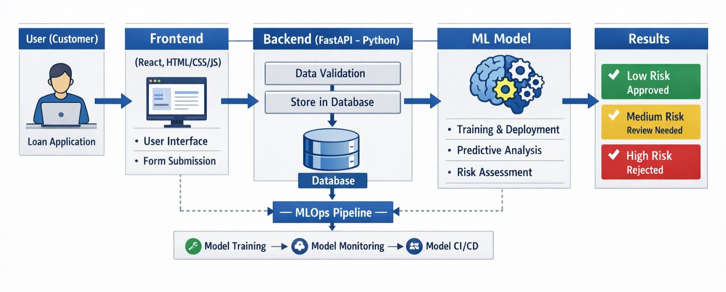
Architectural design

Slide 6
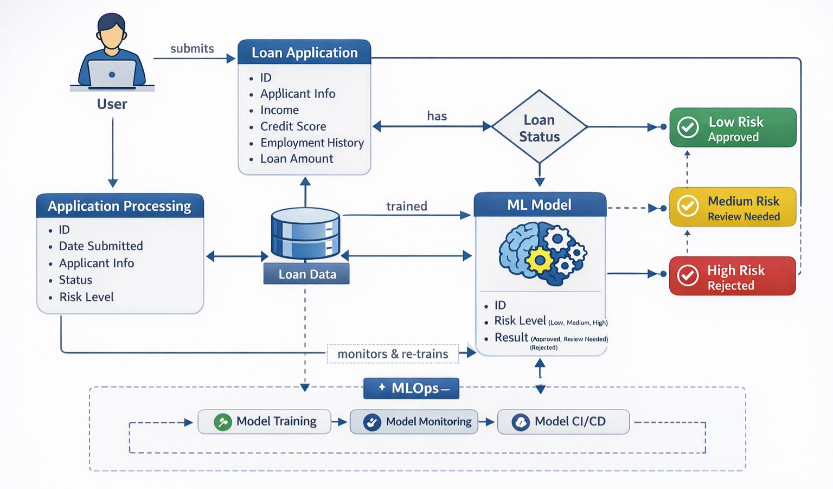
ER Diagram

Slide 7
Algorithms
Data Preprocessing: Removes missing values, encodes categorical data, and scales features to improve model accuracy.
Train–Test Split: Divides the dataset into training and testing sets to evaluate model performance.
Logistic Regression: Calculates the probability of loan default and classifies applications into risk categories.
Risk Classification: Uses probability thresholds to label loans as Low, Medium, or High Risk.
MLOps: Continuously monitors model performance and retrains the model with new data.

Slide 8
Complexity Analysis
Data Preprocessing – O(n): Each record is processed once to clean and transform the data.
Model Training – O(n): The Logistic Regression model learns from all training samples.
Risk Prediction – O(1): Risk is predicted instantly for a single loan application.
Model Retraining (MLOps) – O(n): When new data arrives, the model is retrained using the full dataset.

Slide 9
Expected Outcomes

Slide 10
REFERENCES
[1]. Kumar, V., & Ravi, V. (2016). "A survey of machine learning techniques in credit risk analysis." Decision Support Systems, 83, 47–63.
[2]. Lessmann, S., Baesens, B., Seow, H. V., & Thomas, L. C. (2015). "Benchmarking state-of-the-art classification algorithms for credit scoring." European Journal of Operational Research, 247(1), 124–136.
[3]. Microsoft Azure Architecture Center. (2020). "MLOps: Continuous delivery and automation pipelines for machine learning." Retrieved from Microsoft Documentation.
[4]. Raj, R., & Sharma, N. (2022). Full Stack Development for Web Applications. McGraw-Hill Education.

Slide 11
REFERENCES
[5]. Google Cloud. (2021). "Effective MLOps: Model development, deployment, and monitoring." Google Cloud Architecture Guide.
[6]. Thomas, L. C. (2009). Consumer Credit Models: Pricing, Profit and Portfolios. Oxford University Press.
[7]. Baesens, B. (2014). Analytics in a Big Data World: The Essential Guide to Data Science and its Applications. Wiley.

Slide 12
QUERIES ??

Slide 13
THANK YOU

